Slide 1
Chapter 4
Project Management

Slide 2
Definitions
Project
A sequence of unique, complex, and connected activities having one goal, completed on time, within budget, and according to specifications.
Project Manager
The person responsible for supervising a project from initiation to conclusion.

Slide 3
Definitions
Project Management
The process of scoping, planning, estimating, scheduling, organizing, directing, controlling, and closing the development of a specific project to be on time and within budget.
Process management
The ongoing activity of documenting, managing, and continually improving the process used for every project.

Slide 4
Reasons Why Projects Fail
Lack of upper management commitment
Lack of systems development methodology
Taking shortcuts
Poor expectations management
  Scope Creep - growth of user expectations
  Feature Creep - addition of technical features
Premature commitment to budget and schedule
Poor estimating techniques

Slide 5
cont’d ...
Over-optimism
The mythical man-month
Inadequate people management skills
Failure to adapt to business change
Insufficient resources
Failure to manage to the plan
Lack of Project Management training

Slide 6
Project Management Tools
PERT Chart
  Project Evaluation and Review Technique
  a graphical network model that depicts a project’s task and the relationships between those tasks
Gantt Chart
  Conceived by Henry L. Gantt
  a simple horizontal bar chart that depicts project tasks against a calendar, each bar representing a named project task

Slide 7
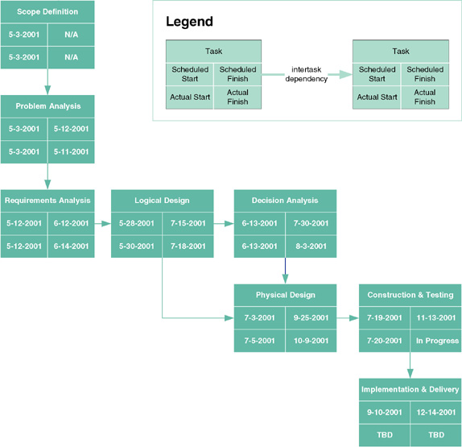
PERT Chart

Slide 8
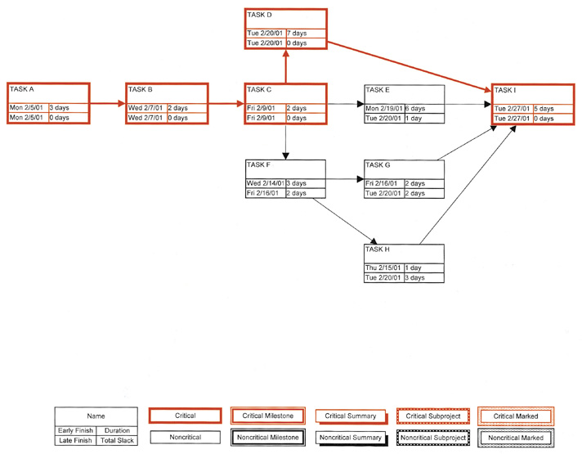
Microsoft Project PERT Chart

Slide 9
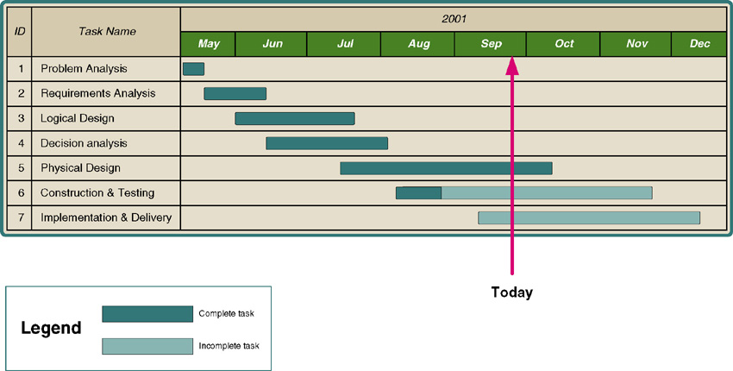
Gantt Chart

Slide 10
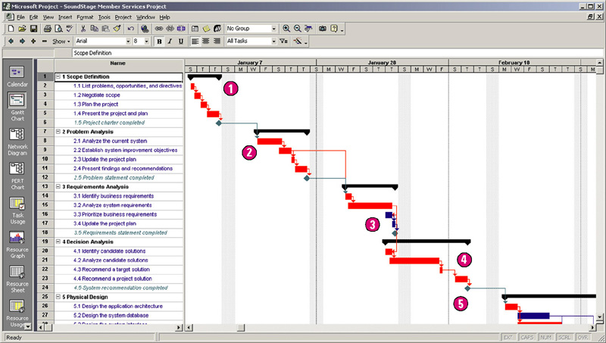
Microsoft Project Gantt Chart

Slide 11
Project Management Activities
1. Negotiate Scope (Scoping)
2. Identify Tasks (Planning)
3. Estimate Task Durations (Estimating)
4. Specify Intertask Dependencies (Scheduling)
5. Assign Resources (Organizing)
6. Direct the Team Effort (Directing)
7. Monitor & Control Progress (Controlling)
8. Assess Successes & Failures (Closing)

Slide 12
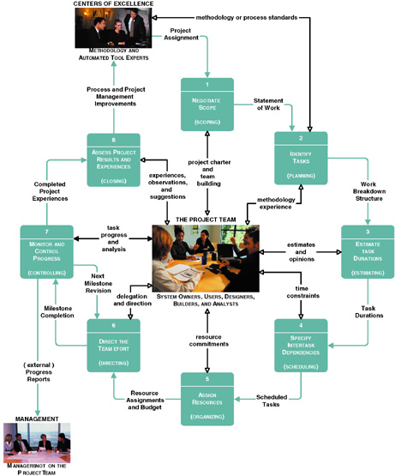
Project Management Life-Cycle

Slide 13
1. Scoping
Joint Project Planning
  a strategy in which all stakeholders attend an intensive workshop aimed at reaching consensus on project decisions
Scope
  defines the boundaries of a project
  Product - What do you want?
  Quality - How good do you want it to be?
  Time - When do you want it?
  Cost - How much are you willing to pay for it?
  Resources - What resources are you willing or able to bring to the table?
Statement of Work
  describes the work to be performed (example on page 131)

Slide 14
2. Planning
Work Breakdown Structure
  is a hierarchical decomposition of the project into phases, activities, and tasks
Milestones
  are events that signify the accomplishments or completion of major deliverables during a project

Slide 15
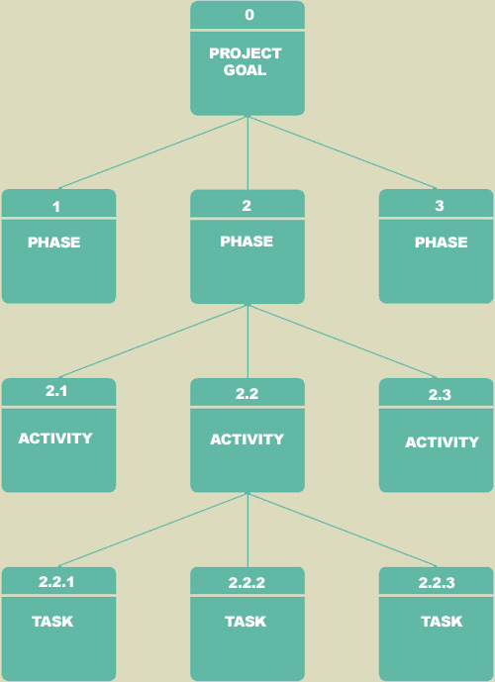
Work Breakdown Structure

Slide 16
3. Estimating
Estimate Task Duration
  1. the optimistic duration (OD - minimum time)
  2. the pessimistic duration (PD - maximum time)
  3. the expected duration (ED – realistic time)
  (consider that the efficiency of workers is 75% and interruptions can consume an additional 10% - 50% depending on the type of work)
then…

Slide 17
… calculate the most likely duration
D = (1 x OD) + (4 x ED) + (1 x PD)
6
OD
ED
PD
3.33 days = (1 x 2 days) + (4 x 3 days) + (1 x 6 days)
6

Slide 18
4. Scheduling
Dependencies
  Finish-to-Start (FS)
  The finish of one task triggers the start of another task
  Start-to-Start (SS)
  The start of one task triggers the start of another task
  Finish-to-Finish (FF)
  Two tasks must finish at the same time
  Start-to-Finish (SF)
  The start of one task signifies the finish of another task
Schedules
  Forward Scheduling establishes a project start date and calculates a project completion date from that date
  Reverse Scheduling establishes a project deadline and schedules backward from that date

Slide 19
5. Organizing (Staffing)
Resources
  People, services, facilities, equipment, materials, supplies, and money
Critical Path
  Sequence of dependent tasks that have the largest sum of expected durations, i.e. the earliest project completion date
Slack Time
  Amount of delay that can be tolerated between the starting and completion time of a non-critical task without causing a delay in the completion date of the entire project

Slide 20
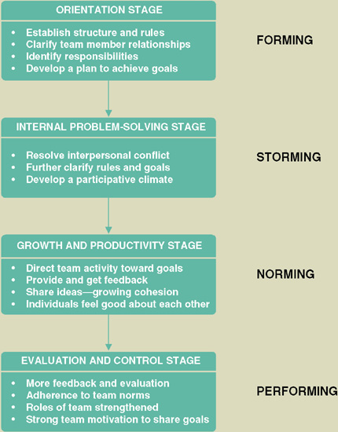
6. Directing
People Management Skills
  Be consist
  Provide support
  Keep promises
  Set realistic deadlines
  Encourage team spirit
  Set perceivable targets
  Praise in public/criticize in private
Stages of Team Maturity
  Forming
  Storming
  Norming
  Performing

Slide 21
7. Controlling
Progress Reporting
  The purpose is to identify problems so that they can be addressed before escalating into major issues or catastrophes (example on page 141).
Change Management
  A process to facilitate project changes to protect the project team from being held accountable for schedule and budget overruns that were due to changes in scope.

Slide 22
Expectations Management Matrix
  A tool used to understand the impact of changing project parameters such as cost, schedule, scope, and quality
Critical Path Analysis
  Awareness of the critical path and task slack times facilitates people management decisions to reallocate resources.

Slide 23
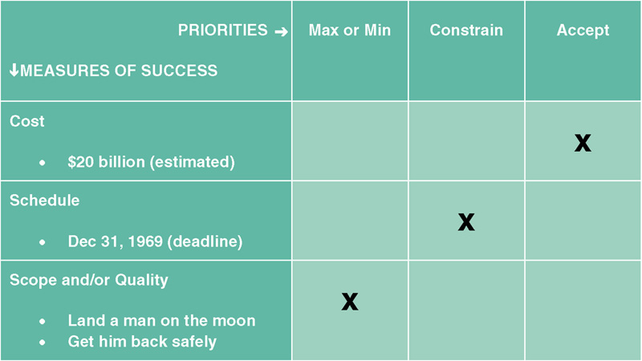
Expectations Management Matrix
(Lunar Project)

Slide 24
8. Closing
Did the final product meet or exceed user expectations?
Did the project come in on schedule?
Did the project come in under budget?

